Slide 1
EMPLOYEE SALES DATA ANALYSIS using EXCEL
STUDENT NAME : S.LAKSHMI PRIYA
REGISTER NO: 312208508 asunm1330312208508
DEPARTMENT: BCOM(GENERAL)
COLLEGE: Chellammal Women’s college

Slide 2
PROJect title
SALES ANALYSIS REPORT
DEALER WISE SALES ANALYSIS
YEAR- 2023-2024
REGION-INDIA

Slide 3

PRODUct offeringS: PERFUMES UNDER 2K TO 10K .

Slide 4
Annual turnover for perfume in 2024
In 2024, the Fragrances market in India is projected to generate a revenue of US$316.90m. This market segment is expected to witness an annual growth rate of 1.49% (CAGR 2024-2028). When compared globally, in the United States leads the pack, generating the highest revenue of US$8,862m in 2024.

Slide 5
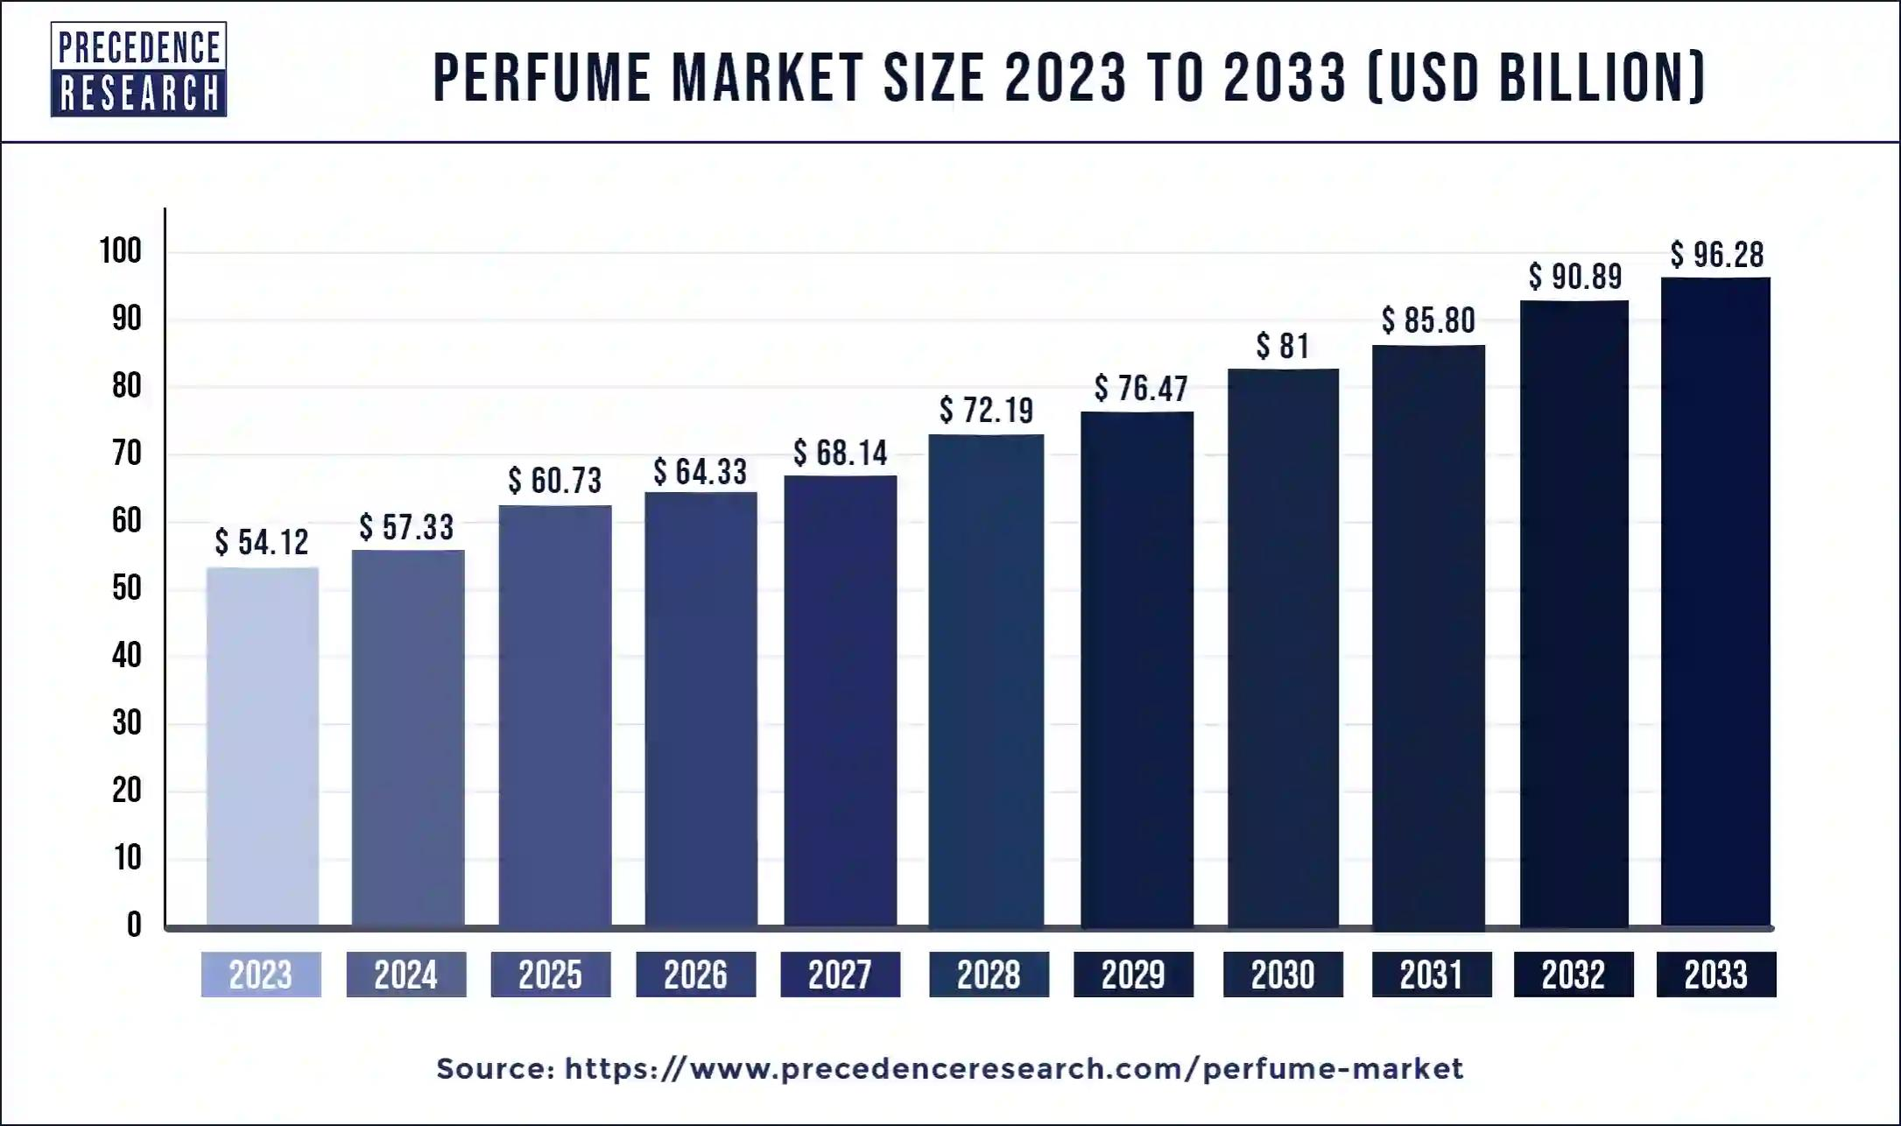
PERFUMES SALES REPORT
The perfumes market size has grown rapidly in recent years. It will grow from $83.48 billion in 2023 to $95.52 billion in 2024 at a compound annual growth rate (CAGR) of 14.4%.

Slide 6
MoST EXPENSIVE PERFUME
Taking this celebrated perfume Clive Christian developed a magnificently decorated crystal flacon for No 1, a piece of extraordinary beauty and rarity, No1 Passant Guardant, which became officially recognised as “The World’s Most Expensive Perfume”.

Slide 7
Time period when enormous sale of perfumes have been made
Perfume sales are highest during the holidays, particularly in the two weeks leading up to Christmas. December alone accounts for more than half of the fourth quarter’s sales. Some say that Black Friday is another popular time for perfume shopping, and that you can find steep discounts on fragrances from brands like Armani, Gucci, and Dolce and Gabbana.

Slide 8
A country where most number of perfumes has been sold
France is a top exporter of perfume, and is known for its perfume industry: Top exporter: In 2022, France was the top exporter of perfume, with $7.24 billion in exports. Perfume capital: Grasse, France is known as the world’s perfume capital. Famous perfumeries: France is home to some of the world’s most famous perfumeries, including Maison Guerlain.

Slide 9

Advertisement
THE ONE AND ONLY MESMERIZING FRAGRANCE

Slide 10
Result
Here’s some information about the financial performance of some companies in Denver, Colorado: CBD of Denver For the three months ending June 30, 2024, CBD of Denver reported a 37.4% increase in revenue from the same period in 2023. Operating expenses were down, and salaries were reduced as a result of cost-saving measures. Gardner Denver Holdings Inc Gardner Denver Holdings Inc reported a net income of $185 million, compared to $179.5 million a year ago. City and County of Denver The City and County of Denver received a Certificate of Achievement for Excellence in Financial Reporting for the year ending December 31, 2021. This award is given by the Government Finance Officers Association of the United States and Canada.

Slide 11
Conclusion
We aim reputed to be a Promising company regarding quality And providing the best fragrances as recommended by Our experts.
We aim to market this product on a large scale so that it’s sales Could reach a peak level in market.
We assure the best quality of the product So that it’s sales could contribute To the repute of our firm.

Slide 12
THANK YOU

